Slide 1
MIMIC
A Critical Care Database
November 13, 2018
Jeff Box, John Giglio, Bill Magill, John Commander, Luke Williams

Slide 2
Agenda
The Journey (8 min)
The Story (5 min)
Questions (2 min)

Slide 3
Methodology
End-to-end analytics paradigm
Process efficiency
Error-reduction in analysis
Value-driven outcome
The Ask
Data Source
Strategy & Metrics
WHY
Data Plan
Data Retrieval
Data Clean
HOW
Analyze
Limitations
Story-telling
WHAT

Slide 4
The Core Message
Overview
The MIMIC-III (Medical Information Mart for Intensive Care) Clinical Database contains comprehensive clinical data from 40,000+ Intensive Care Unit (ICU) patients. This data is analyzed for predictive analysis and machine learning purposes.
Hypothesis
Ho: The first blood lab events are not good predictors for classifying likelihood of mortality and subsequent information.
Ha: We can classify patients as likely to die and predict their length of stay (LOS) or days to death (DTD) based on their first blood labs on admission.
Business Case
Can this model improve patient care and potentially save lives?
Can we prioritize important clinical measures at the time of patient admission?
Can we understand and optimize patient throughput?
Notes:
Obtained from https://mimic.physionet.org/ and requires granted permissions

Slide 5
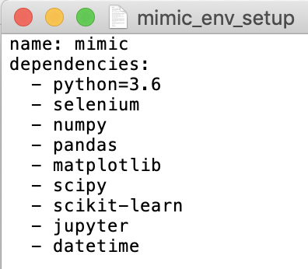
Source & Resources
Data: aggregated csv query from database, “…”
Tool: Python 3.6 “mimic” custom environment
Deliverables:
Jupyter Notebook containing ML solution
Visualization outputs for deeper understanding
Documentation and presentation containing explanation and methodology

Slide 6
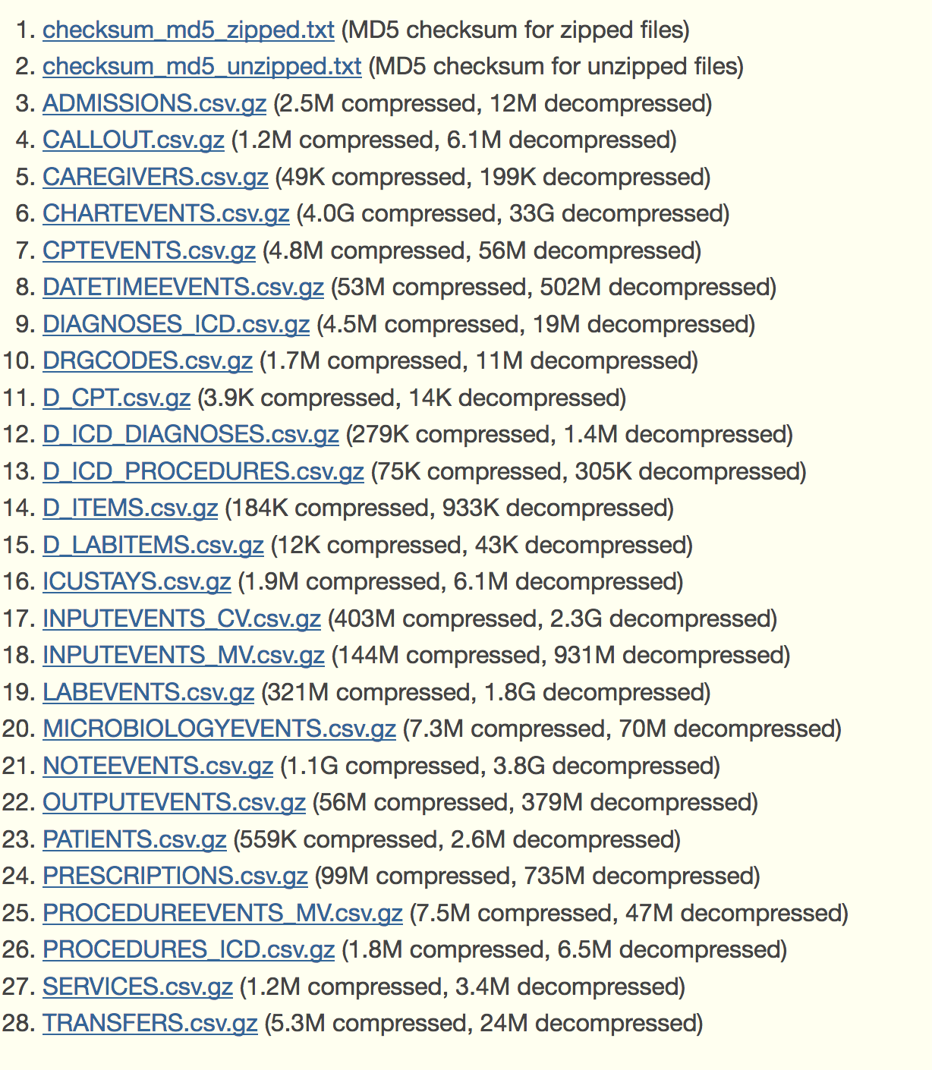
Data
A permission-only database
Mixed data types
Many attributes across 28 CSVs
Many patient admissions
Blinded time and demographic data
Notes:
General - Patient demographics, hospital admissions & discharge dates, room tracking, death dates (in or out of the hospital), ICD-9 codes, unique code for health care provider and type (RN, MD, RT, etc). All dates are surrogate dates because of privacy issues, but time intervals (even those between multiple admissions of the same patient) are preserved.
Physiological - Hourly vital sign metrics, SAPS, SOFA, ventilator settings, etc.
Medications - IV meds, provider order entry data, etc.
Lab Tests - Chemistry, hematology, ABGs, imaging, etc.
Fluid Balance - Intake (solutions, blood, etc) and output (urine, estimated blood loss, etc).
Notes & Reports - Discharge summary, nursing progress notes, etc; cardiac catheterization, ECG, radiology, and echo reports.

Slide 7
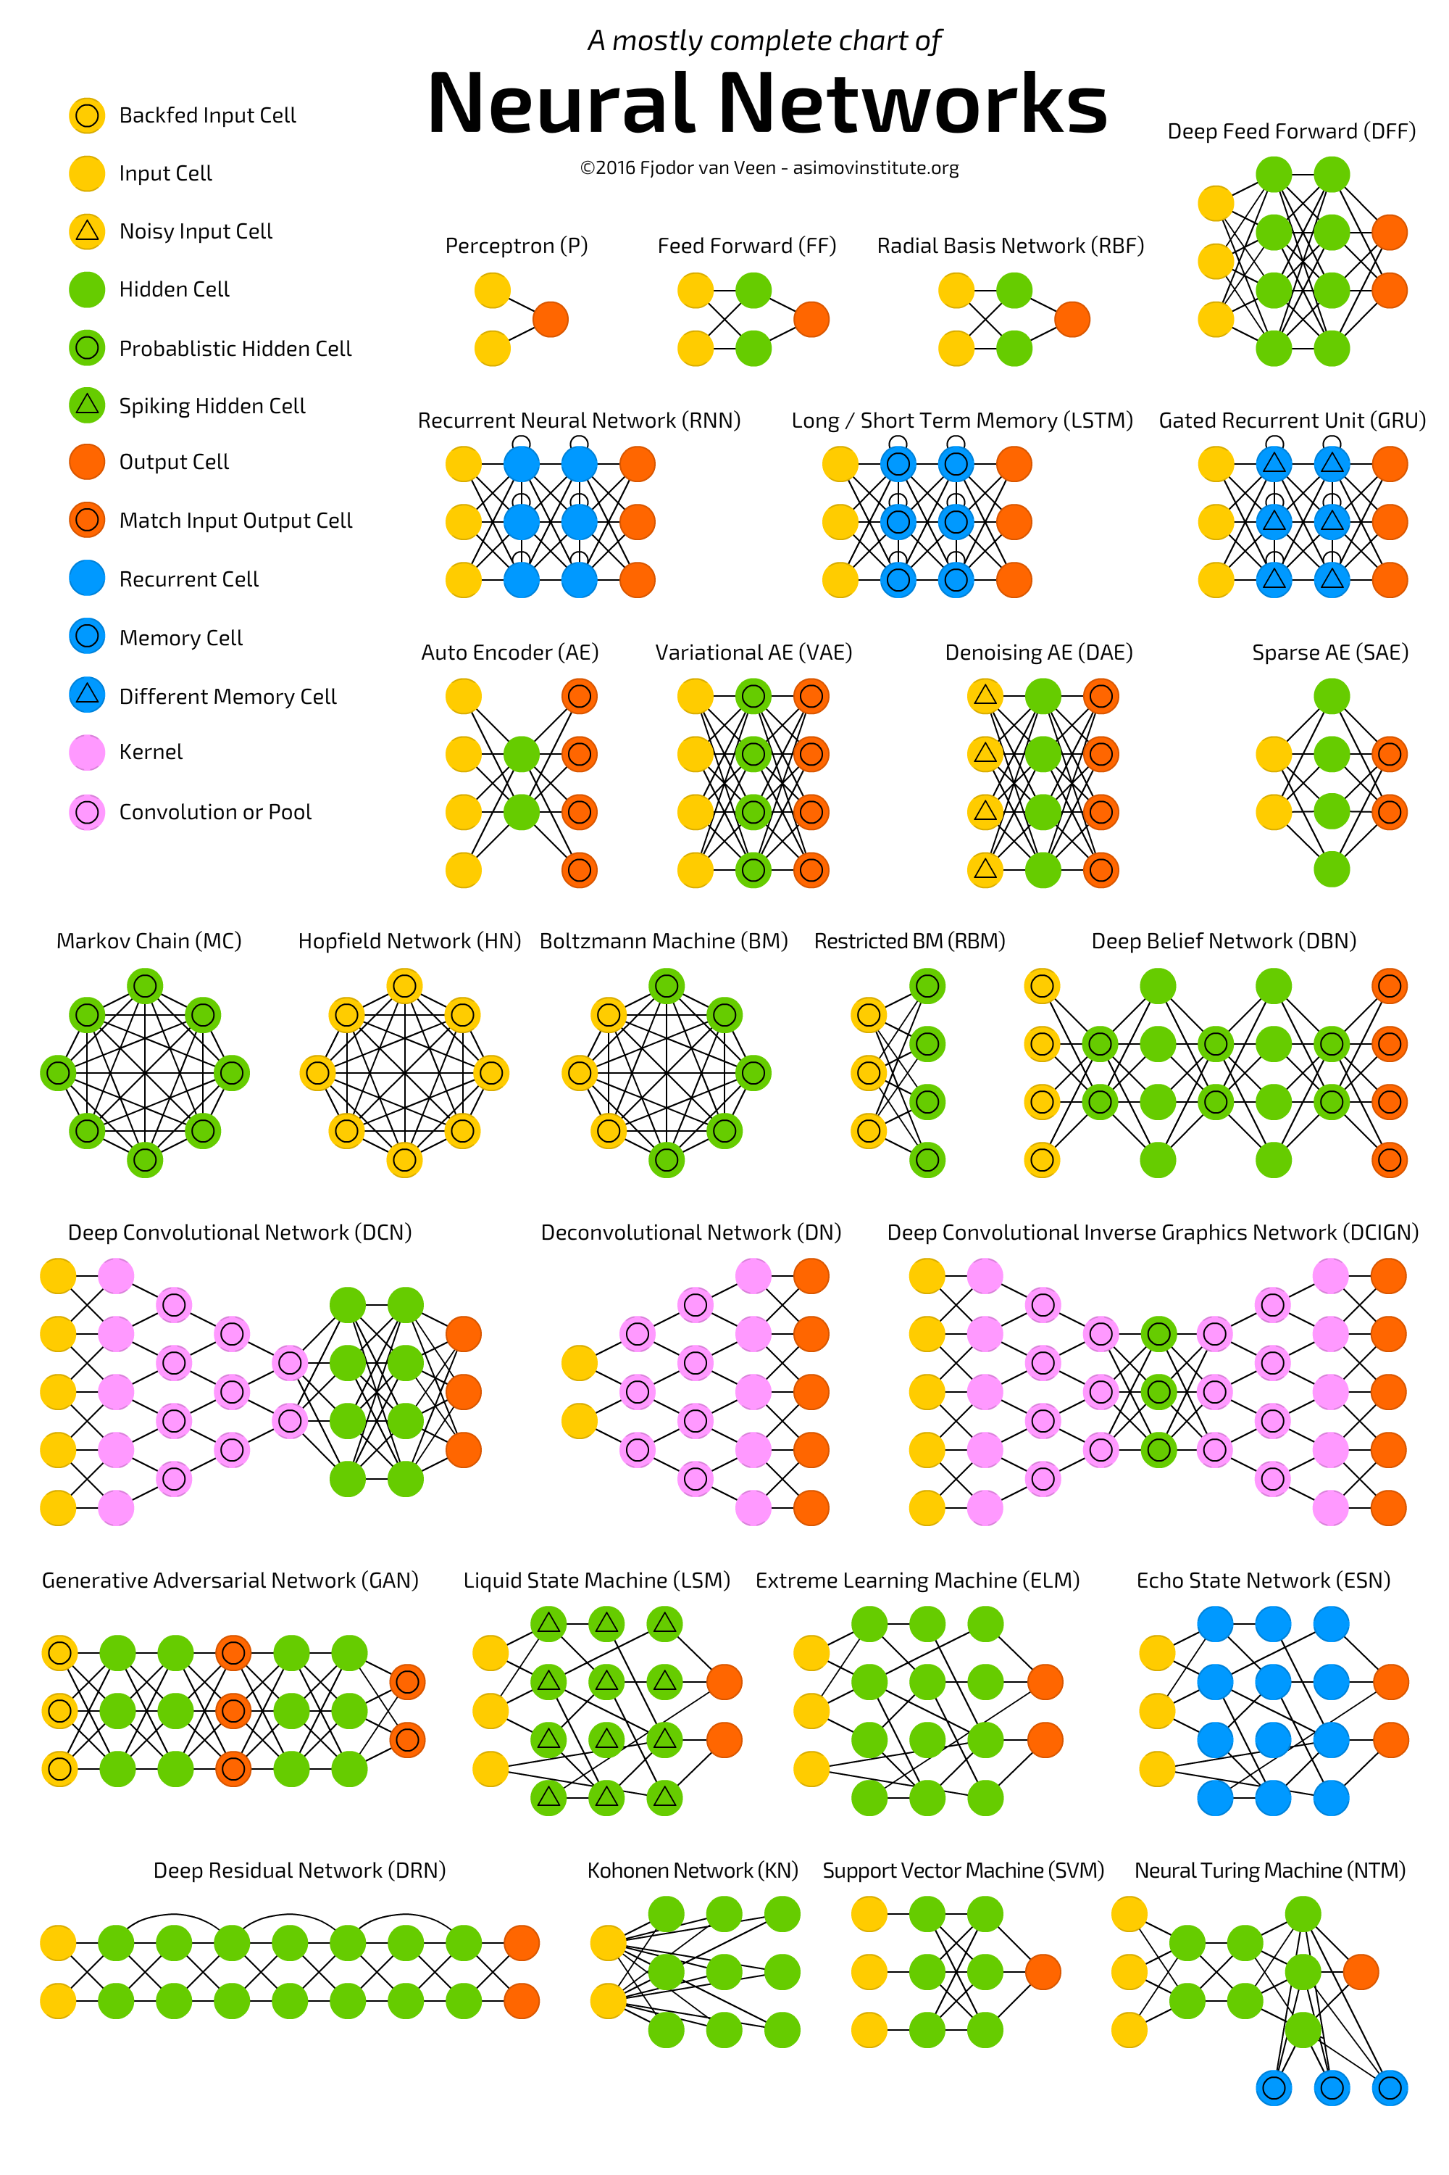
The Strategy
We are trying to classify mortality probability given a set of features
From there, we are trying to predict LOS and TTD depending on the classification with the same set of features
Therefore the strategy is: use a neural network and a multi-variate regression via a Supervised Learning (ML) model to classify and predict

Slide 8
Data Munging
Clean
Identifying which datasets are relevant and why (27M + rows data)
Took first lab event (blood test) for each admission to get usable and unique records
Nulls represented where a test did not occur, so a new category was created
Aggregate
Merged blood gas, hematology, and chemistry to get unique “labs”
Merged “labs” with patient data on admissions ID to include mortality
Transform
Mapped each lab value as normal, abnormal, or did not test (pivot to “tidy”)
Calculated Days To Death (DTD) and Length of Stay (LOS) based on provided fields
Dummy data for all qualitative features

Slide 9
Analysis
Identify multiple models to explore and validate
NN
Logistic Regressor
Linear Regression
SVM
Random Forests
First, classify patients as likely to live or die
The output should include probabilities as well as classes (0 & 1)
The classifier and prediction models use the same input, but in the future can be used for current patient data
Then, predict LOS & DTD
Multivariate regression
A robust, scalable classifier and a rank of feature importance

Slide 10
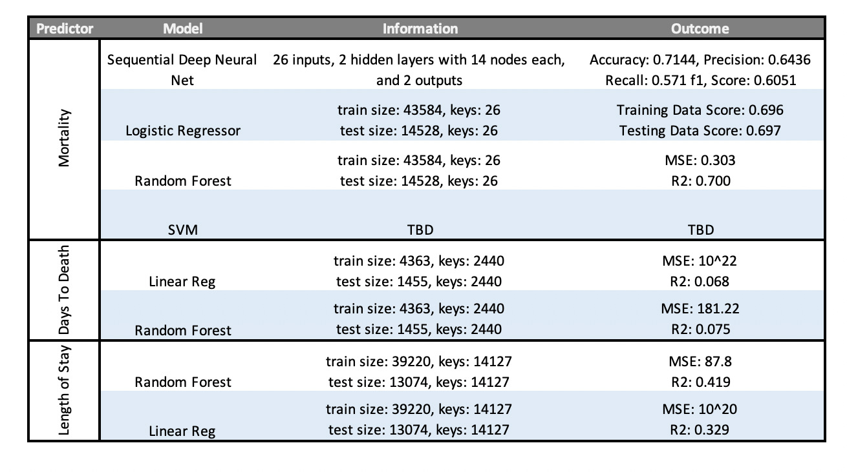
Model, Train, & Predict
Sequential deep NN model with 26 inputs using the relu activation at input and learning and the softmax activation at the output. Rough mean for number of nodes.
Create Train and Test datasets to validate the model and prevent overfitting. Used default distribution: Train = 75%; Test = 25%

Slide 11
Classifier Differences
Looking at only the first 100 data points

Slide 12
Feature Importance
Looking at cumulative < 50% of RF feature importance method
Admissions - lived
Admissions - died

Slide 13
Fail to reject Ho… for now!
Limitations
Blinded data that made some demographic feature analysis difficult due to HIPAA compliance
Database ownership was private
Shortage of time
Next Steps
Better feature selection for linear models by pruning the random forest
Using additional features in the database outside of blood labs
Test without the ‘normal’ categories using ’absolute distance from normal’
Experiment with additional models

Slide 14
Questions?

